Slide 1
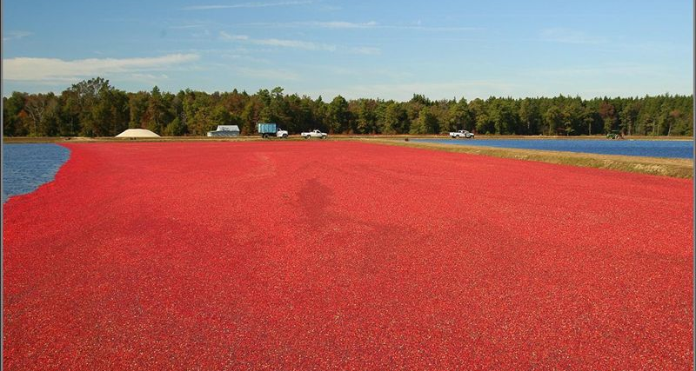
“Eat local”: The potential benefit of cranberries for your colon
Catherine C. Neto, Ph.D.
Department of Chemistry and Biochemistry
UMass Dartmouth
Director, UMass CHRC
Cranberry
Health
Research
Center

Slide 2
A local hero: the North American Cranberry Vaccinium macrocarpon (Ericaceae)
Traditional uses of cranberries by native Americans included treatment of urinary, bladder and kidney ailments and wounds
Today, cranberry is known mainly for protection against urinary tract infections (UTI), but may have other potential health benefits
.
Plenty of Polyphenols!
http://northsouthconnections.com/img/cranberry.jpg

Slide 3
CHRC Research Objectives
Investigate the cranberry plant as a source of compounds possessing biological properties to help fight disease and maintain health
Antimicrobial, antioxidant, anticancer and antiinflammatory
Characterize the secondary metabolites
Conduct studies with well-defined extracts
Investigate cellular and molecular mechanisms of action
Validate with in vivo models
Translate to humans

Slide 4
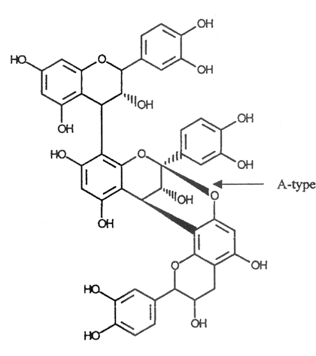
Classes of secondary metabolites in cranberry
Flavonols
Proanthocyanidins (PACs)
Flavonoids
or polyphenolics
Iridoids
Triterpenoids: ursolic acid
Isoprenoids

Slide 5
Using bioassay-guided fractionation, we identified compounds in whole cranberry fruit that inhibit tumor cell proliferation
Table 1: Inhibition of tumor cell growth by compounds isolated from cranberries, 48 h in vitro SRB assay
GI₅₀ in μg/mL
Cell line PAC fr Ursolic esters Quercetin
H460 (lung) 20 16 ---
ME180 (cervical) >125 14 18
DU145 (prostate) >125 17 16
MCF-7 (breast) 100-125 11 13
M-14 (melanoma) >125 28 18
HT-29 (colon) 110 20 21
HCT116 (colon) 25-100 < 10 60
PC3 (prostate) >125 15 13
K562 (leukemia) 70 17 11
Based on 48 hr NCI SRB assay
Murphy, B.T.; Neto, C. et al, J. Agric. Food Chem. 51: 3541-45 (2003)
Neto, et al, J. Sci. Food Agric. 86: 18-25 (2006)

Slide 6
Cranberry polyphenols (PACs) inhibit migration and colony formation by colon tumor cells over a 2 week period
Clonogenic assay:
assesses effect on ability of cells to migrate, loss of normal contact inhibition between the cells
Colony inhibition occurs at doses well below the IC₅₀ (Liberty, et al, 2009)

Slide 7
Cranberry compounds also increase levels of apoptosis
% apoptotic cells
Figure 2: DNA fragmentation in HT-29 colon tumor cells after 48 hr incubation with cranberry compounds (TUNEL data)
Liberty, A. M., Amoroso, J. W., Hart. P.E., Neto, C. C, Acta Horticulturae, 841: 61-66 (2009).

Slide 8
Microarray analysis shows that cranberry PACs modulate gene expression in HCT-116 cells
Table 2: Changes in expression of genes associated with apoptosis and MAPK (mitogen-activated protein kinase) signaling pathway in response to PACs
Gene | Up or Down Regulation | Fold Change | P Value
MAP3K | Up | 1.36 | 7.02× 10⁻³
MAP2K1 | Up* | 1.53 | 4.29 ×10⁻³
MAPK1 (ERK) | Down* | 0.41 | 4.00 ×10⁻²
BCl 10 (anti-apoptotic) | Down | 0.50 | 3.88 ×10⁻³
BID (pro-apoptotic) | Up | 1.68 | 2.34 ×10⁻³
BAX (pro-apoptotic) | Up | 1.75 | 2.25 ×10⁻³
* confirmed by protein expression analysis (Western blot)
Liberty, Ferreira, Drew & Neto, unpublished data
Notes:
A possible mechanism by which cranberry limits tumor cell proliferation is by inducing apoptosis. We evaluated whole cranberry extract in a tumorigenic and a nontumorigenic breast epithelial cell line. Both were treated with whole cranberry extract for 48 hours after which apoptotic cells were identified by fluorescent dye labeling (green cells in the photo are apoptotic). Cranberry induced apoptosis in MCF-7 tumor cell lines to a significant degree without causing similar damage in the normal epithelial cell line.

Slide 9
Effect of cranberry on inhibition of colon tumor formation in AOM/DSS mouse model Hang Xiao (UMass Amherst, Food Science) Cathy Neto (UMass Dartmouth) Funded by the UMass Cranberry Health Research Center

Slide 10
Objectives
The effects of three different cranberry preparations on colitis-associated colon carcinogenesis were investigated in AOM/DSS-treated mice.
Azoxymethane is a colon specific carcinogen, dextran sulfate sodium induces inflammation in the colon.
This model mimics colitis-associated colon carcinogenesis.
The goals are to determine cranberry’s efficacy in reducing the number and volume of tumors and compare extracts of different composition.

Slide 11
Materials and methods: Preparation of cranberry extracts
Cranberry fruit (Early Black variety) was harvested at State Bog, Wareham, MA (Sept. 2012)
2 kg freeze-dried and powdered (CB powder)
1 kg extracted with methanol/acetone/water, desugared and concentrated (polar extract)
Solids further extracted with ethyl acetate (nonpolar extract)
Total phenolics determined by Folin-Ciocalteu
Flavonoids quantified and characterized by HPLC
Ursolic acid quantified by ¹H NMR methods

Slide 12
Materials and methods: Animal feeding study
Four groups of mice (n=20) were treated with AIN-93G diet containing one of the following, for 20 weeks:
control diet, no cranberry
whole cranberry (freeze dried, 1.5%)
polar extract of cranberry (0.1%)
nonpolar extract of cranberry (0.05%)
Dosages of extracts reflect relative content in whole fruit powder
Polar extract is concentrated in polyphenols: approx. 10% anthocyanins, 5% flavonols, 25-30% PAC oligomers
Nonpolar extract contains ursolic acid (17%), sterols, carotenoids, other lipids

Slide 13
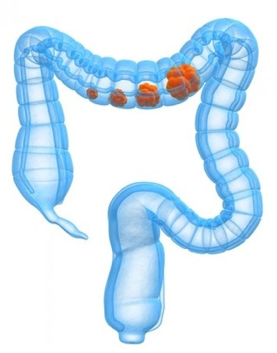
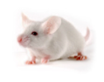
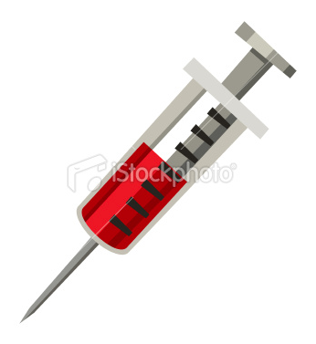
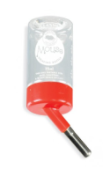
Experimental design
DSS
DSS
DSS
DSS
AOM
Control Diet
(AIN-93G)
Cranberry Powder
(1.5%)
Polar
extract ( 0.1%)
Non Polar
extract
( 0.05%)
Mice age
(weeks)
5 6 7 8 9 10 11 12 13 14 27

Slide 14
Methods (cont’d)
After 20 weeks on diet, mice were sacrificed
Number and volume of colon tumors was assessed
Tissues were fixed and analyzed for the presence of inflammatory markers (ELISA) and changes in expression of pro-inflammatory genes (PCR)

Slide 15
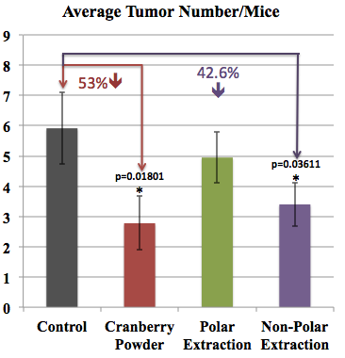
Results
Figure 3: Average number of tumors per mouse

Slide 16
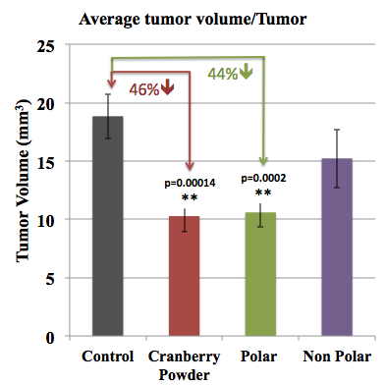
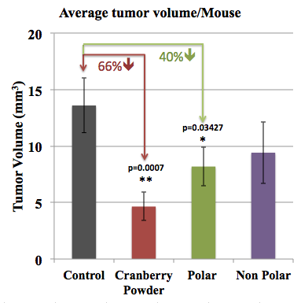
Results
Figure 4: Average tumor volume recorded (a) per tumor and (b) per mouse

Slide 17
Levels of pro-inflammatory markers in tissues decreased in response to diet enriched in cranberry powder or extracts
Figure 5: Levels of IL-1, IL-6 and TNF-α in tissues, measured by ELISA

Slide 18
Expression of pro-inflammatory genes in colon decreased in response to cranberry diet
Figure 6: Alteration of gene expression in colon tissue, measured by qRT-PCR

Slide 19
Summary
In vitro studies have identified several cranberry compounds that inhibit colon tumor cell proliferation and induce apoptosis, including polyphenols and isoprenoids.
Oral administration of whole cranberry or nonpolar extract to AOM/DSS mice significantly reduced the average number of colon tumors per mouse (53%).
Treatment with either whole cranberry or polar fraction resulted in significant decreases in tumor volumes (between 40-66%).
Treatment with cranberry significantly decreased the expression of proinflammatory cytokines IL-1 and IL-6, and mRNA levels of iNOS and COX-2.
Cranberry shows some potential to decrease inflammation and limit colon carcinogenesis.

Slide 20
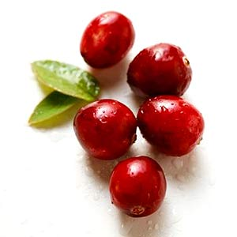
Acknowledgements
UMass Dartmouth
Anne Liberty
Tracie Ferreira
Sarah Frade
Anuradha Tata
Biqin Song
Jason MacLean
Brian Murphy
Miwako Kondo
UMass Amherst
Hang Xiao
Mingyue Song
Xian Wu
Cranberry
Health
Research
Center
Funding: UMass CHRC/UMass President’s S&T Initiative
Cranberry Institute, UMD Cranberry Research Program
Notes:
I’d like to acknowledge my collaborators and students who have worked on past and current projects discussed here, and our funding sources.

